Slide 1
HOSTEL ROOM ALLOCATION AND MAINTENANCE SYSTEM
Mohammed Ismail C | B180437CS
Fadi Noushad P | B180492CS
Muhammed Shifan P | B180501CS
Abid Ali Karuvally Pathikkal | B180466CS
Indrajith T S | B180486CS

Slide 2
Introduction
Hostel Management System is a web application designed for automating the hostel room allocation. It also provides other features such as informing hostel authorities about any complaints or queries.
This application intends to provide a very user friendly easy to use experience with the efficiency of using database design. So the web app eliminates the long hectic process of applying to any hostel and the need for being physically present while submitting the forms

Slide 3
Objective
Simplification of the process of allocation and management of different hostels under an institute.
Creation of a database that allows monitoring and managing hostel requirements and functions in an efficient manner.
Reduce data redundancy and human error to some extent.
Solution for the large amount of file handling happening in the hostels.
Providing a platform to address student issues regarding stay to hostel authorities without delay and avoiding unattended or missed out complaints.

Slide 4
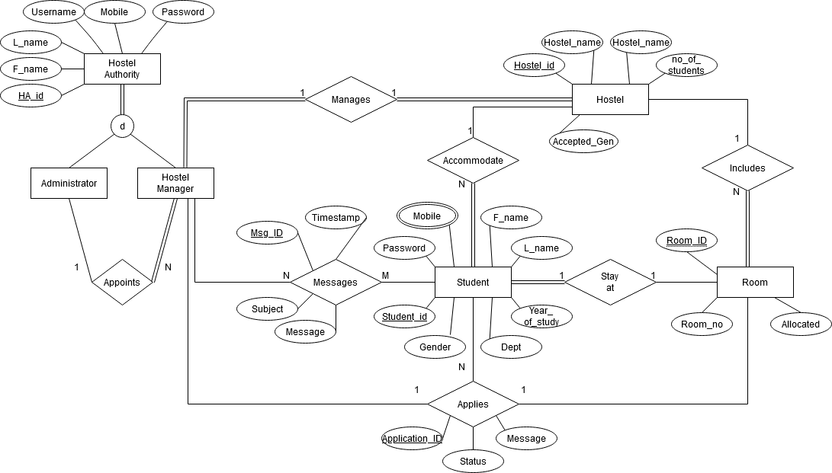
E-R Diagram

Slide 5
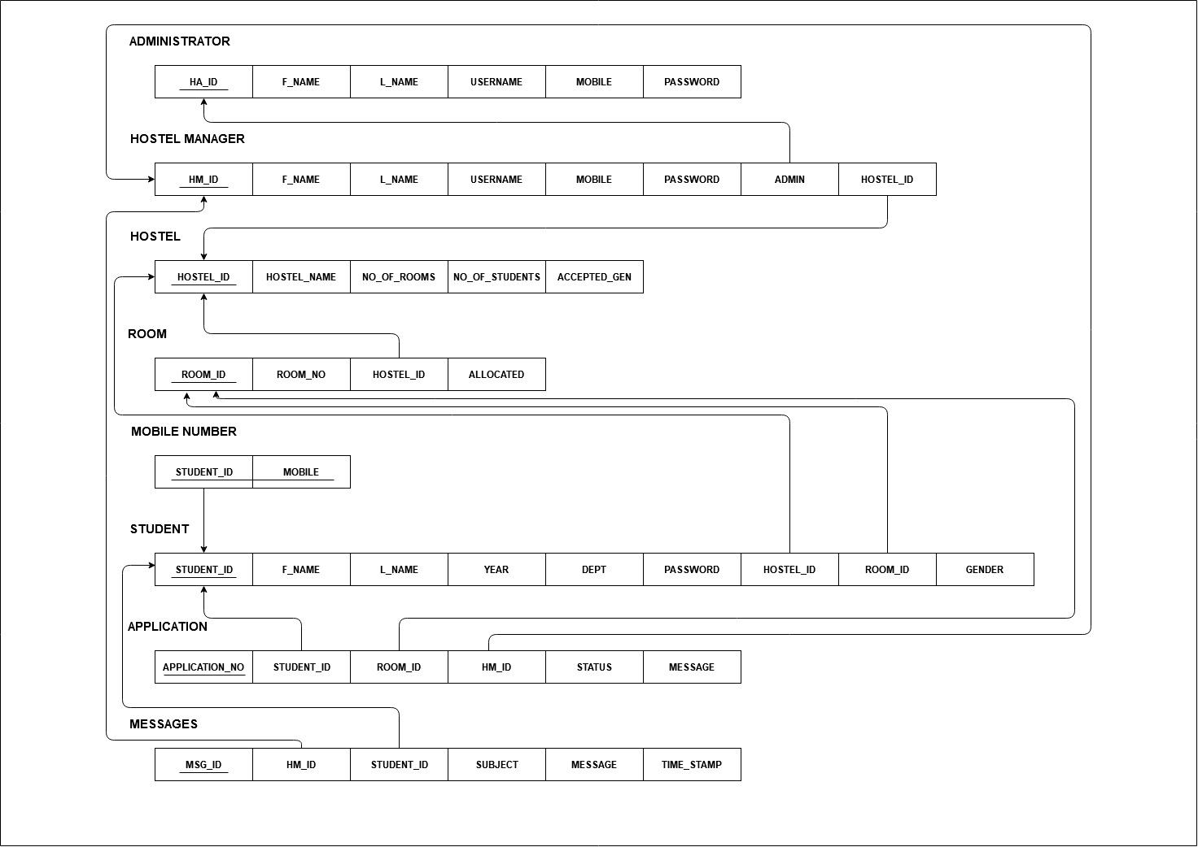
Relational Database Design

Slide 6



Types of Users
Student
Hostel Manager
Hostel Administrator

Slide 7
STUDENT
Login page
Signup Page
Home page
Hostel
Contacts
Profile

Slide 8
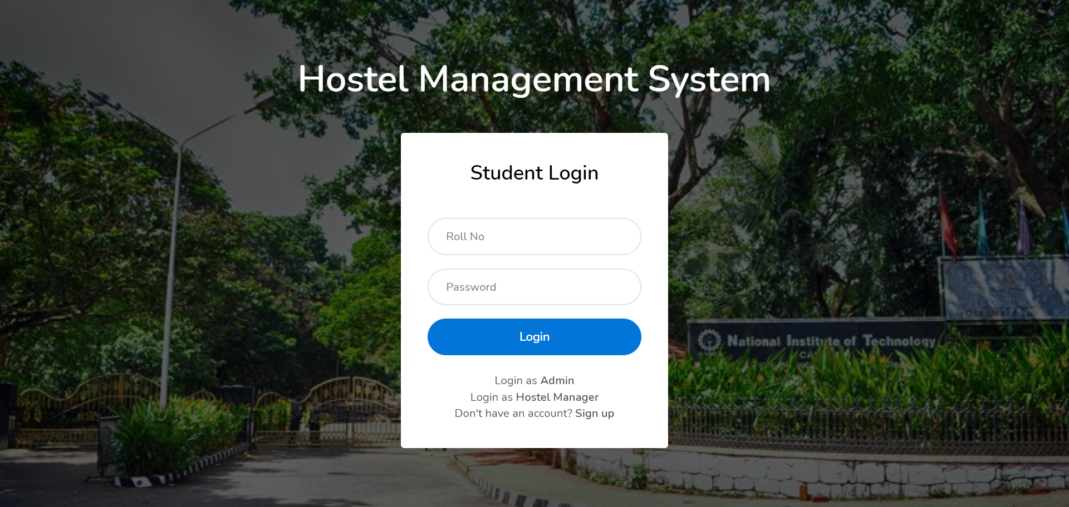
Student Login Page

Slide 9
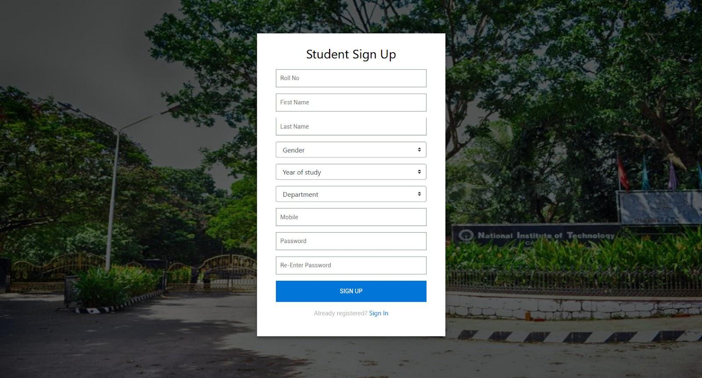
Student Signup Page

Slide 10
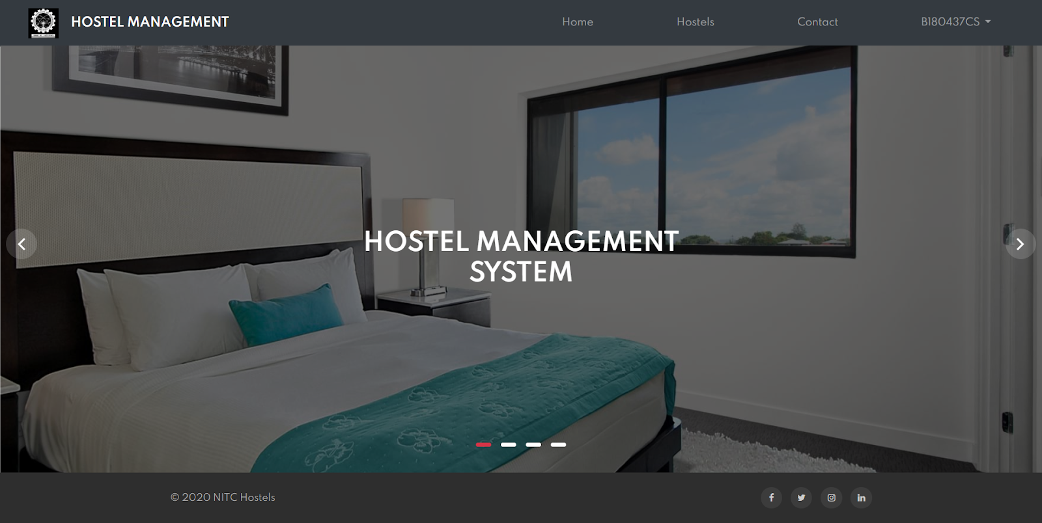
Student Home Page

Slide 11
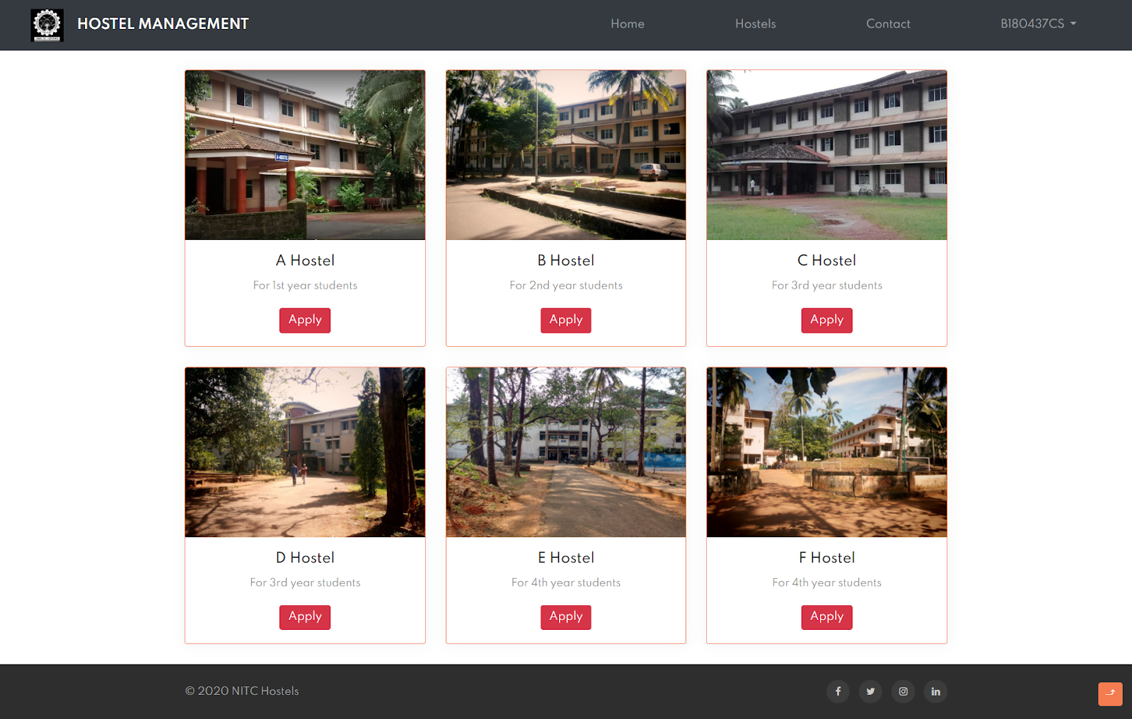
Applying to Hostels

Slide 12
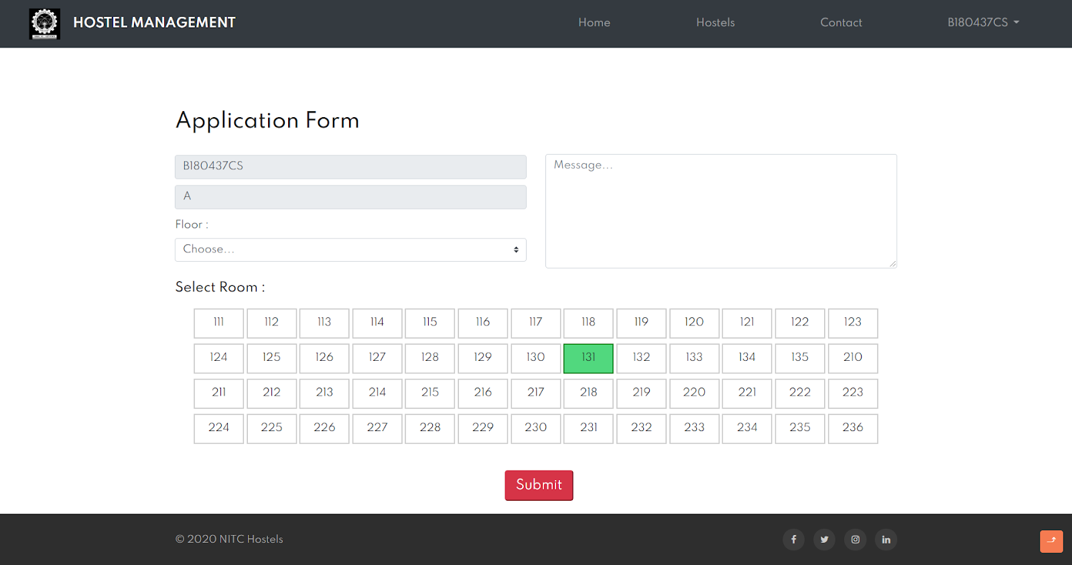
Hostel Application Form

Slide 13
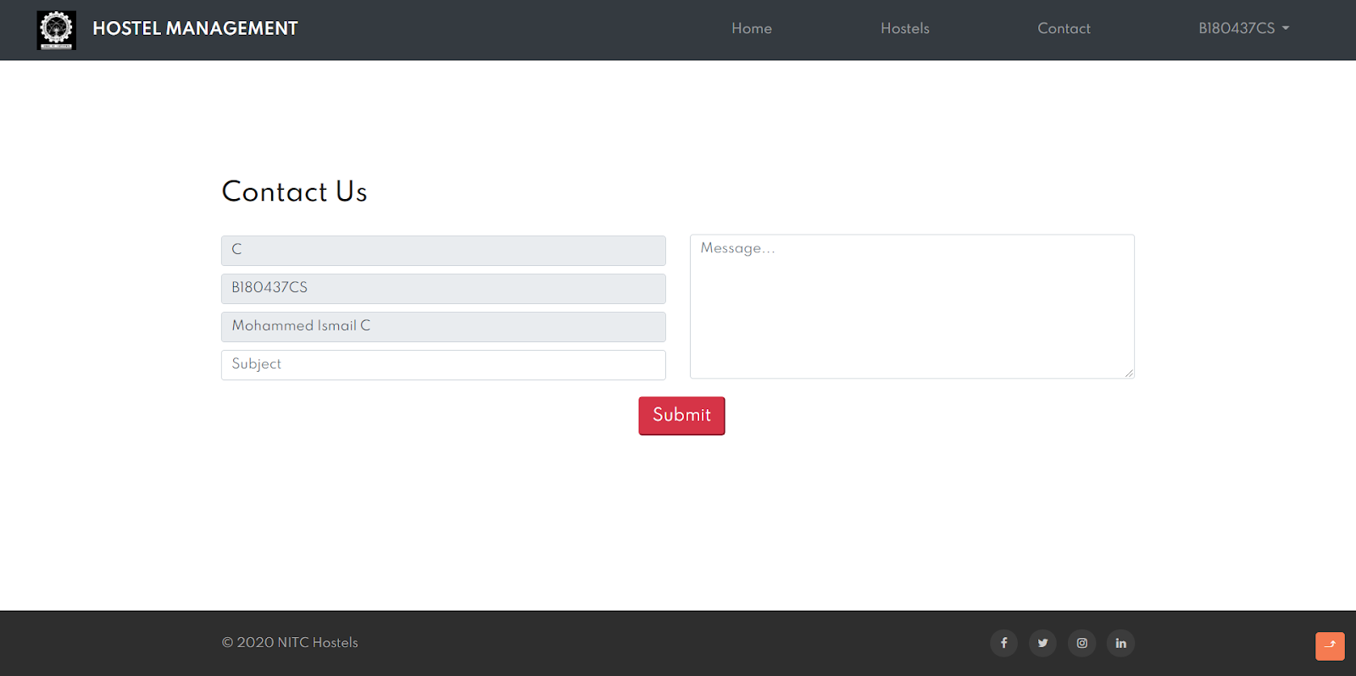
Contact Page

Slide 14
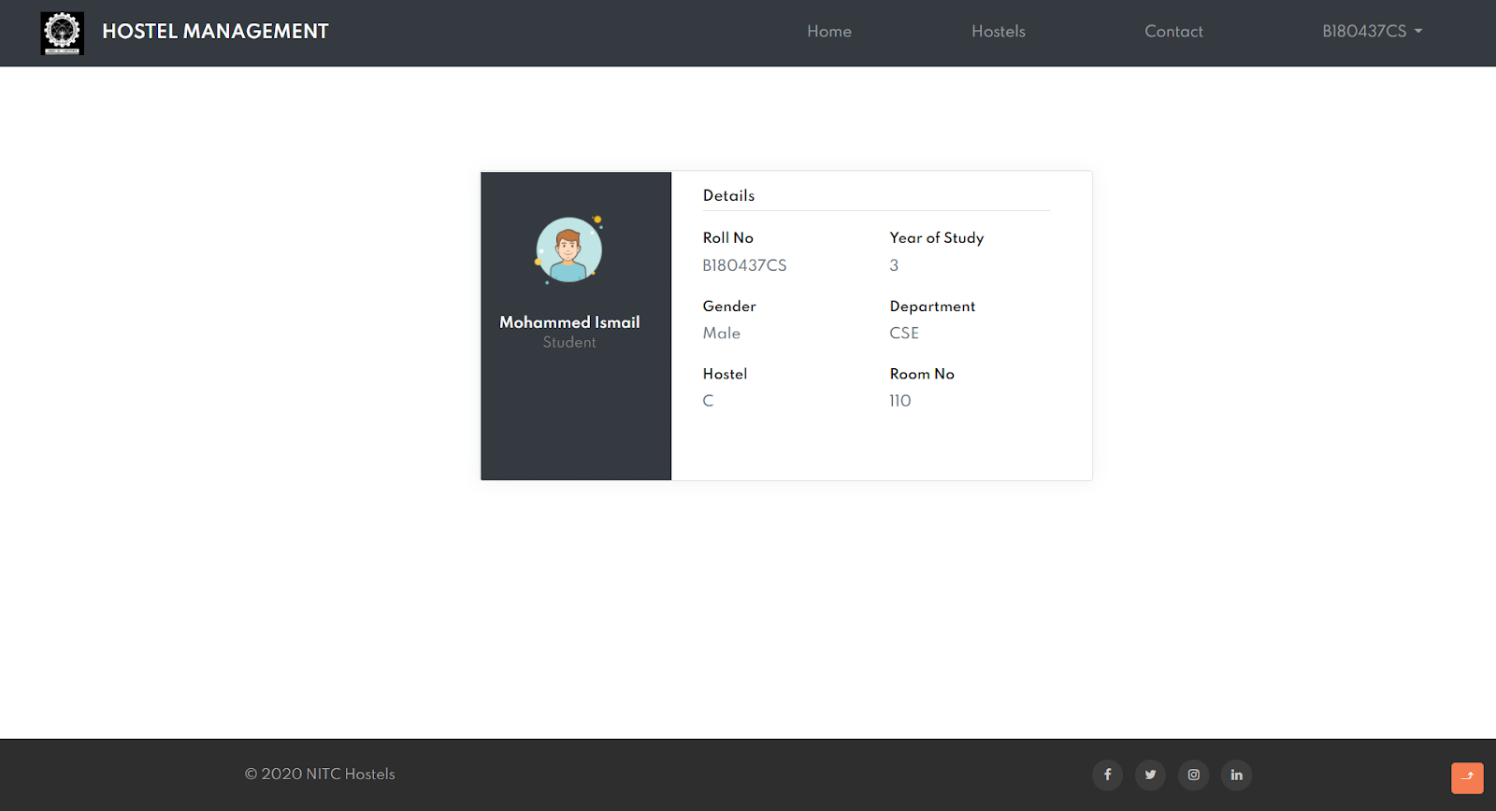
Student Profile

Slide 15
HOSTEL MANAGER
Login page
Home page
Room allocation
Messages
Rooms
Allocated rooms
Empty rooms
Vacate rooms

Slide 16
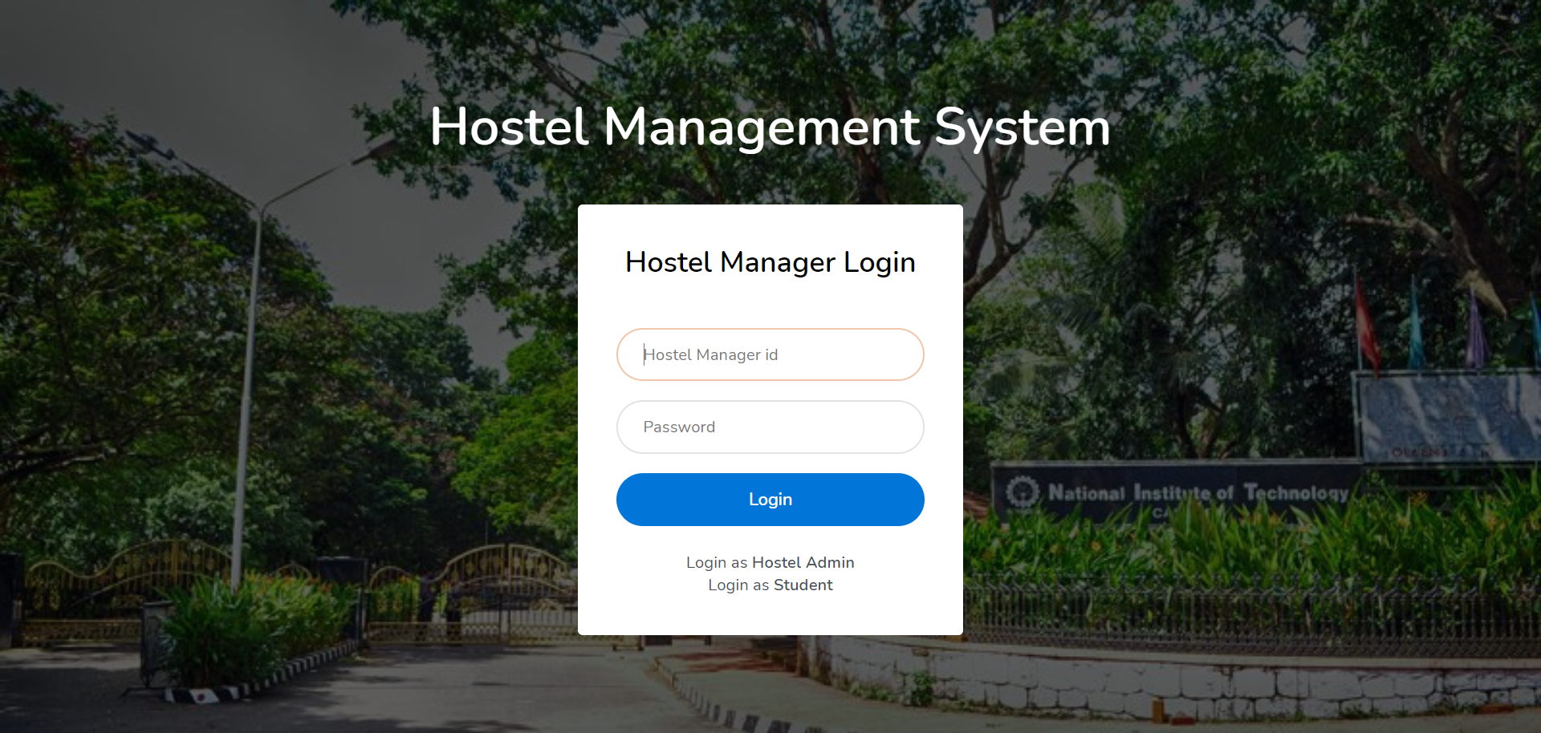
Hostel Manager Login Page

Slide 17
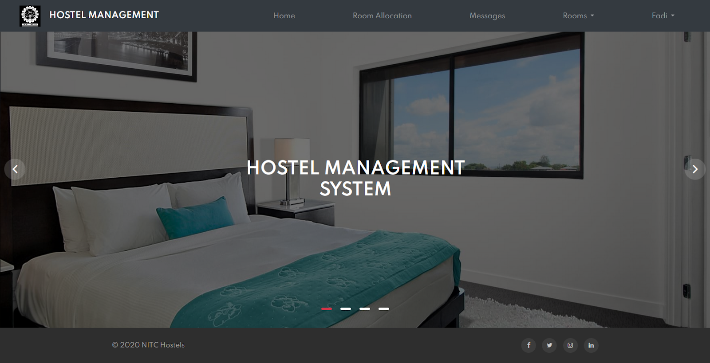
Hostel Manager Home Page

Slide 18
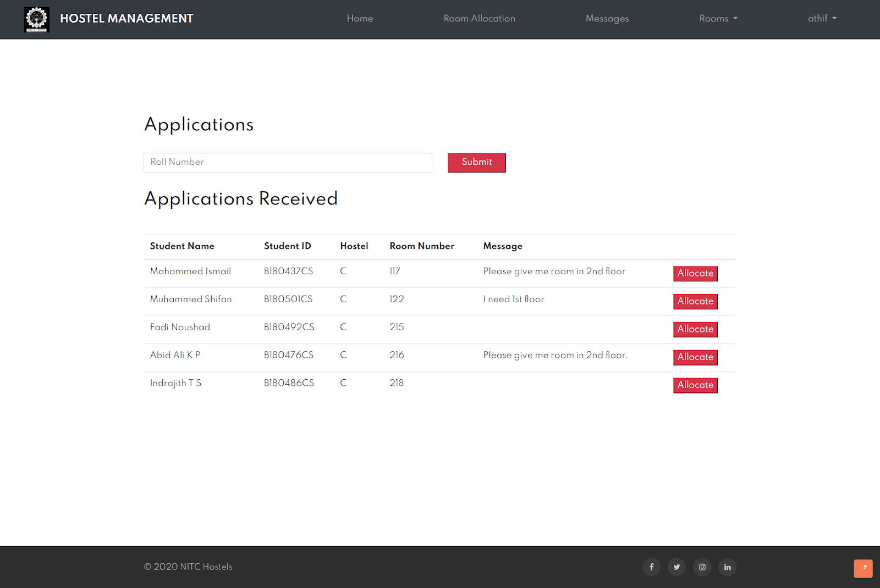
Hostel Manager Room Allocation Application Receiving Page

Slide 19
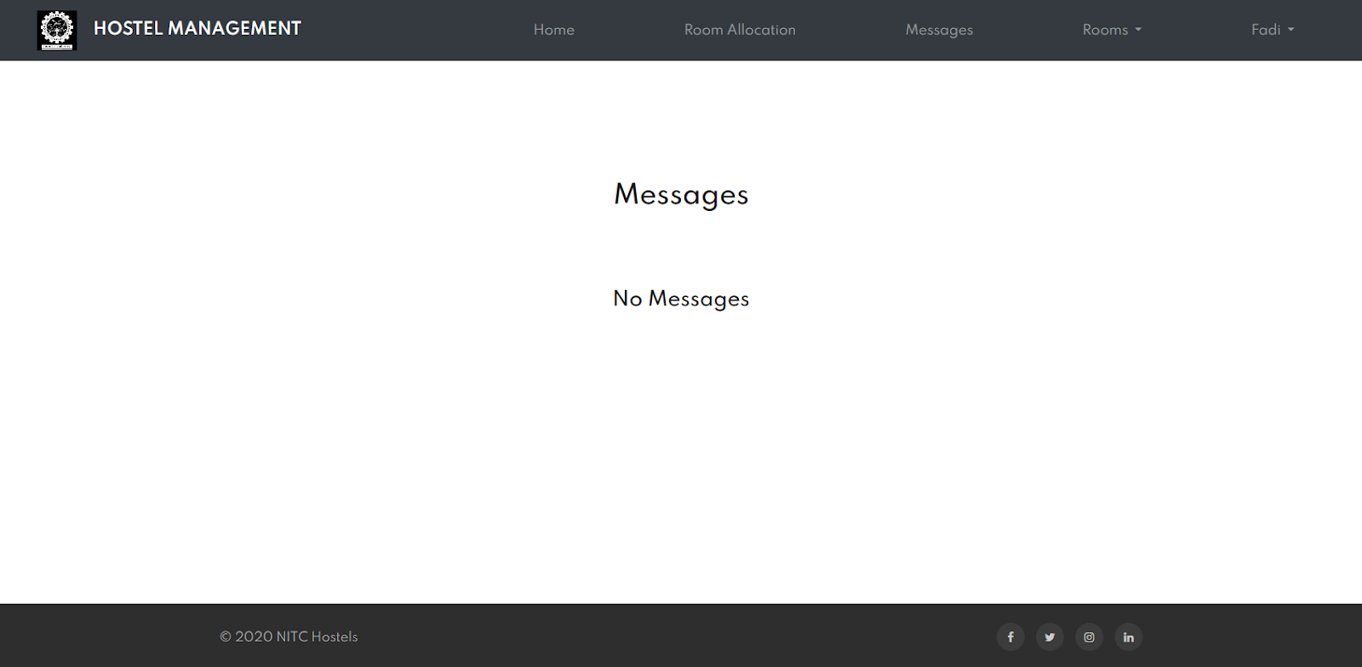
Hostel Manager Message Page

Slide 20
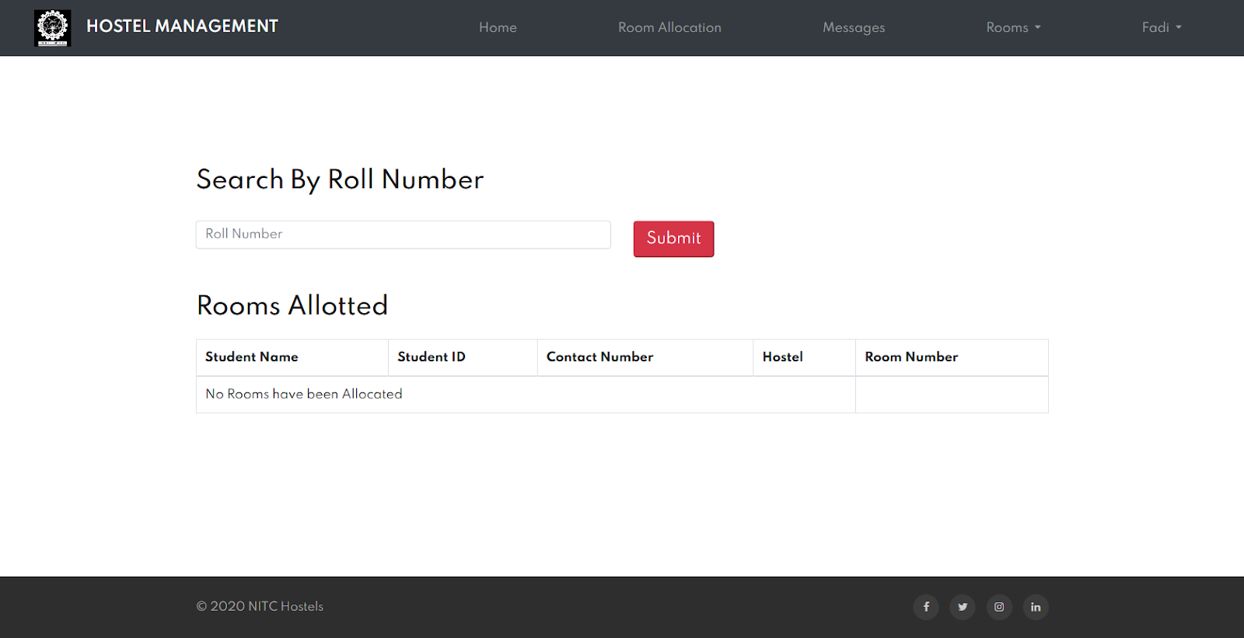
Hostel Manager Student Search

Slide 21
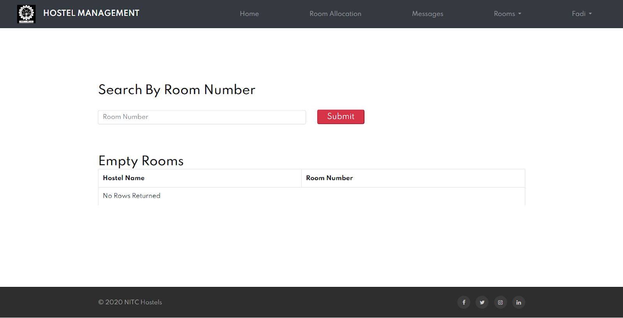
Hostel Manager Non-Allocated Room list

Slide 22
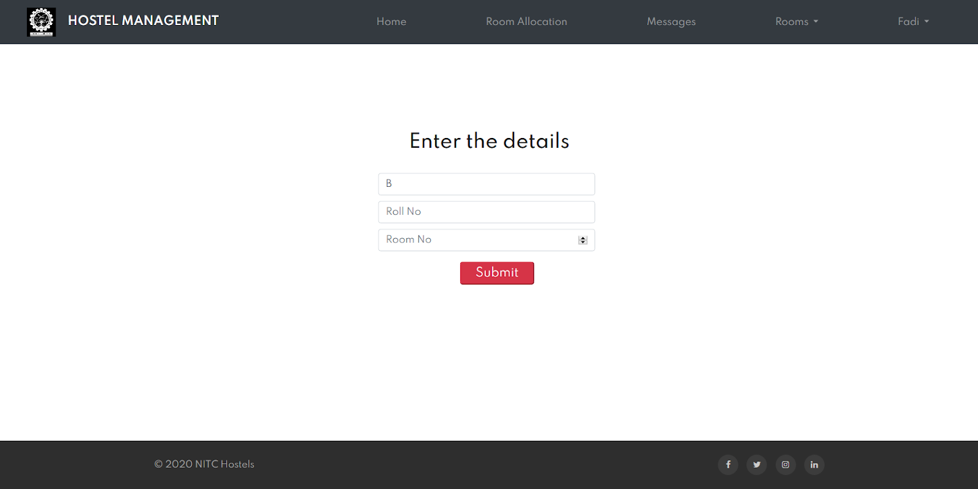
Hostel Manager Vacate Room

Slide 23
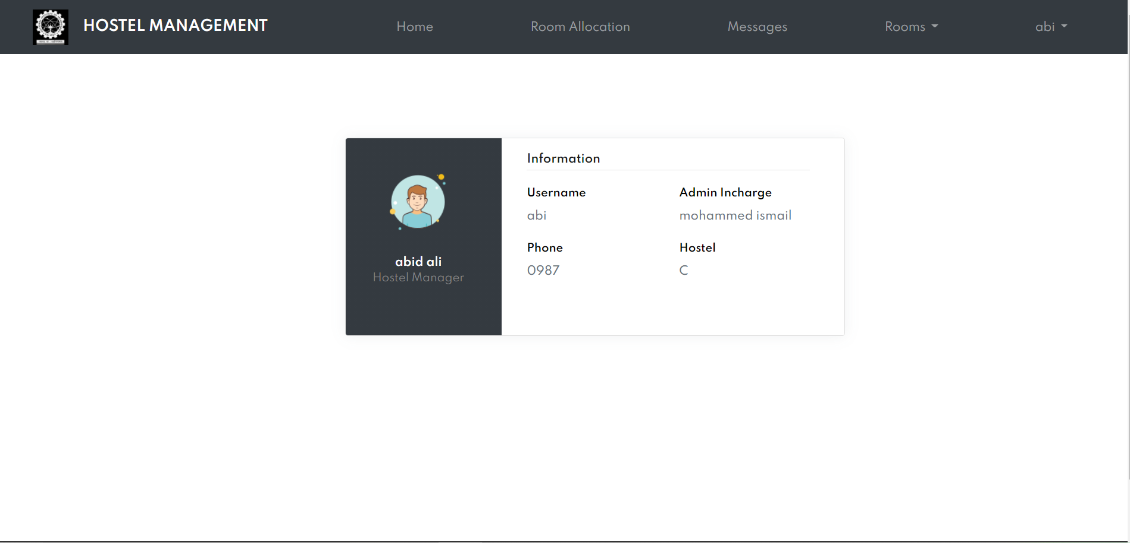
Hostel Manager Profile

Slide 24
ADMINISTRATOR
Login page
Home page
Hostel Manager Appoint
Hostel Manager Removal
Searching Student based on RollNo
Profile

Slide 25

Hostel Admin Login Page

Slide 26
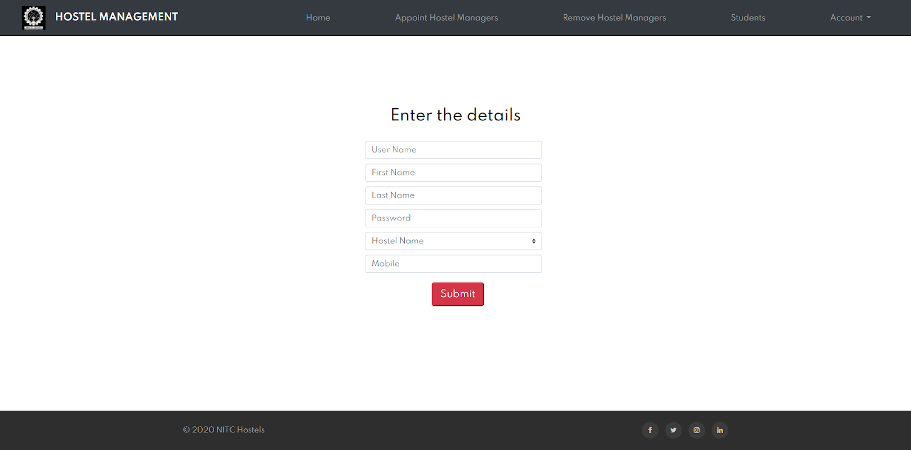
Hostel Admin Appoints Hostel Manger

Slide 27
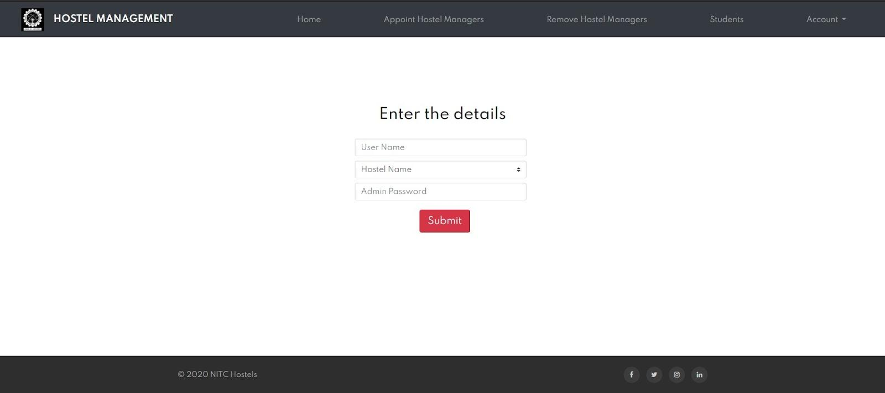
Hostel Admin Remove Hostel Manager

Slide 28
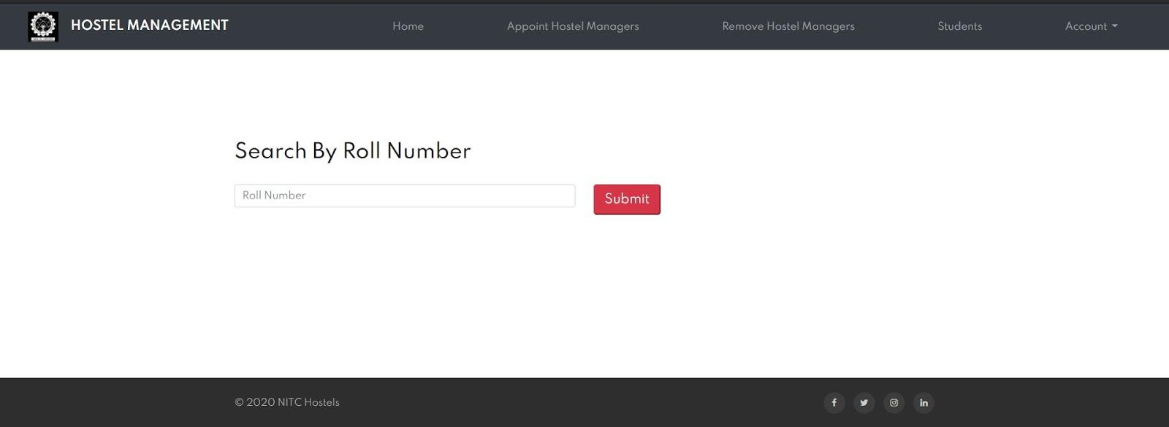
Hostel Manager Search Student

Slide 29
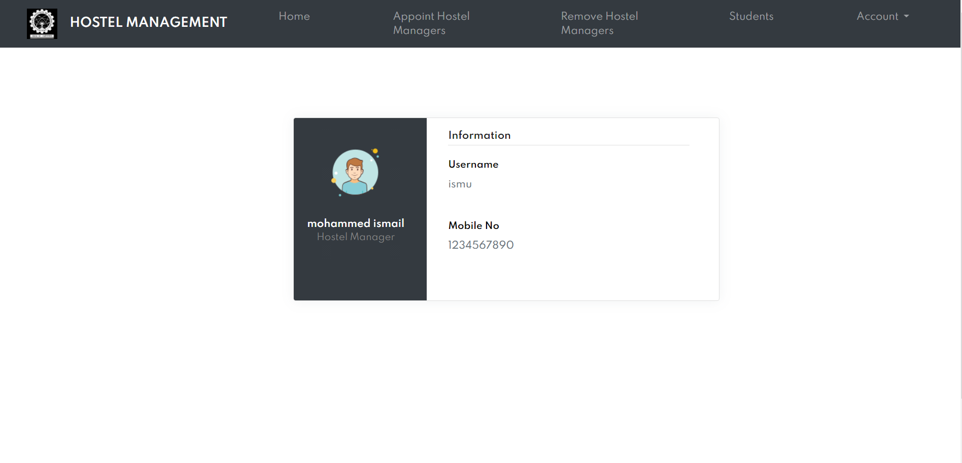

Slide 30
Thanks!
Any questions?
You can find the source code@
https://github.com/mohammedismailb18/Hostel-Management-System

